Slide 1
Bipedal Robot Gait Analysis Using 5-Bar Mechanism
RAS 557: Foldable Robotics
Jahnav Rokalaboina
Nihar Masurkar
Kunal Nitin Palasdeokar

Slide 2
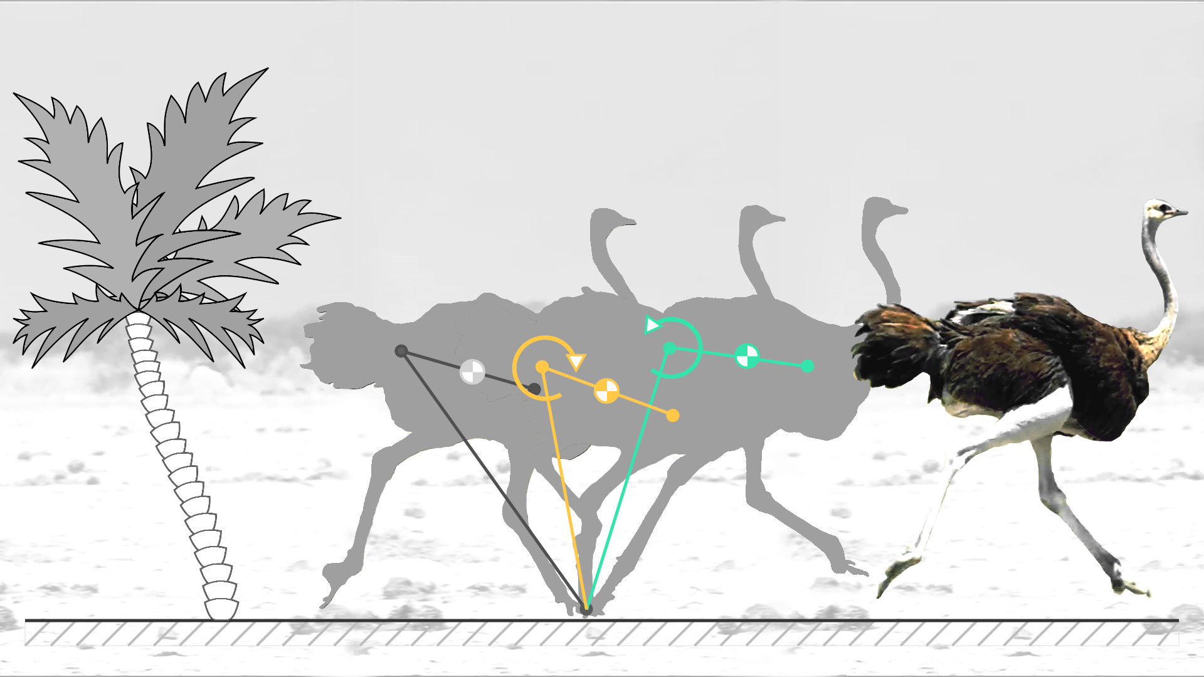
Contents:
Problem Statement
Kinematic Analysis
Simulation
Modeling
Optimization
Manufacturing planning
Experimental validation
Conclusion and Future Scope

Slide 3
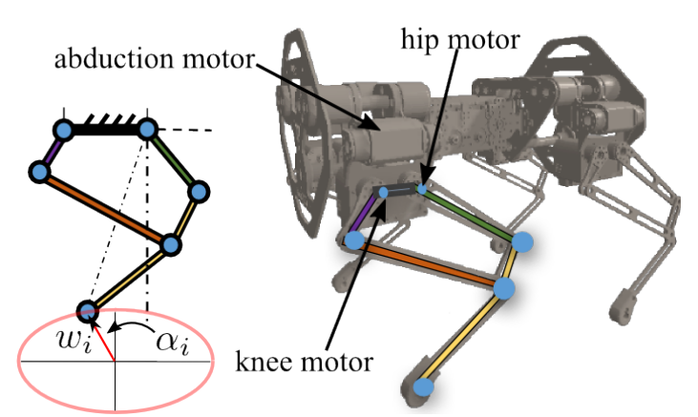
Problem Statement:
Bipedalism is the ability of animals to walk or run by bearing weight on two legs, a trait often seen in birds and some mammals, including humans.
This project's scope is to replicate two legs of a bird, such as an ostrich, and study primary walking gait, using a foldable five-bar mechanism.
A streamlined methodology to optimize the end effector length and its effect on gait pattern is to be evaluated using simulation and validated using experimental analysis.

Slide 4
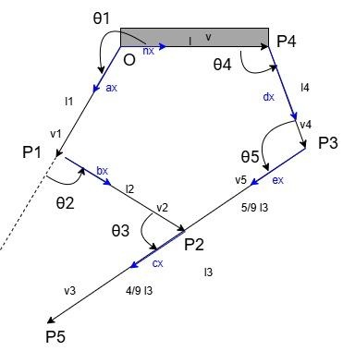
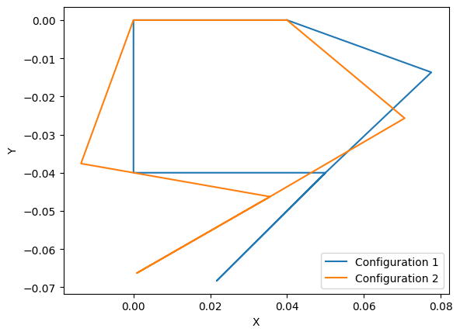
Kinematic Analysis:

Slide 5
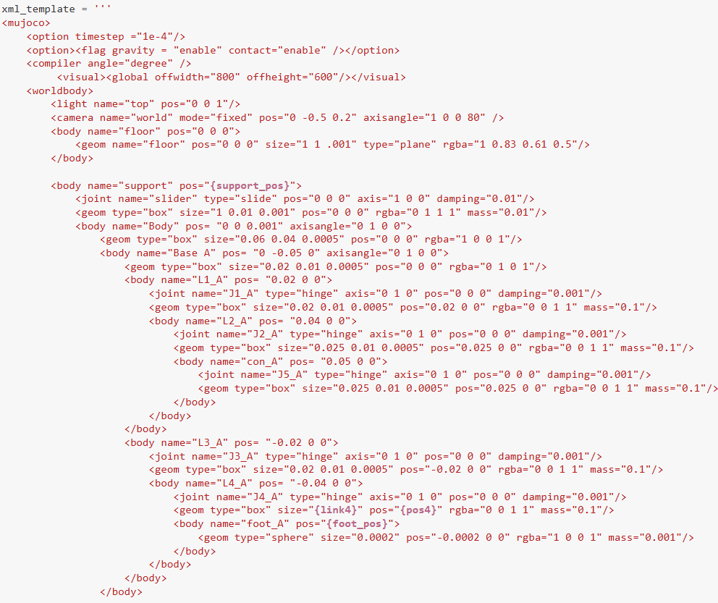
Simulation:
Setting up the xml template:
Template allows us to change few variables
Support Height: This helps in suspending and supporting robot using a prismatic joint to enable either static or dynamic simulation
Link Length: End effector length which is the design variable to be studied

Slide 6
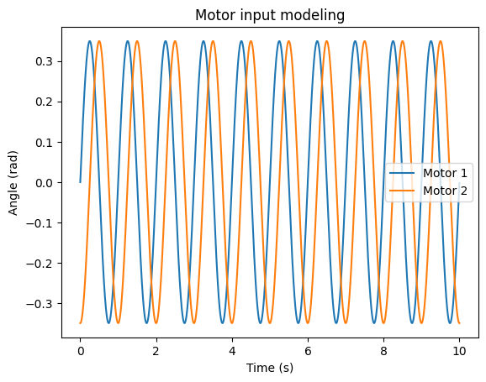
Simulation:
Motor Input Modeling

Slide 7
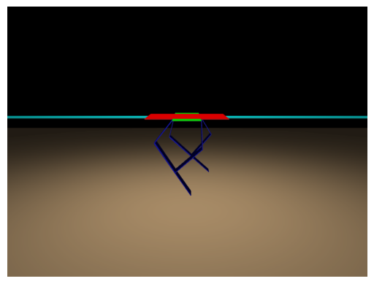
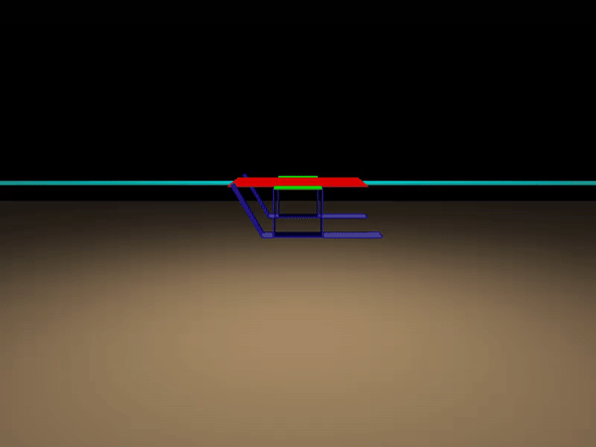
Simulation:
Static Testing

Slide 8
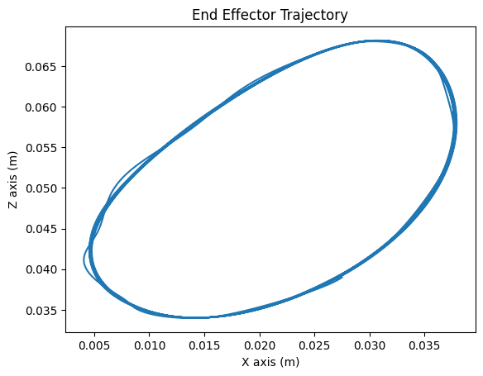
Simulation:
End effector trajectory for static testing

Slide 9
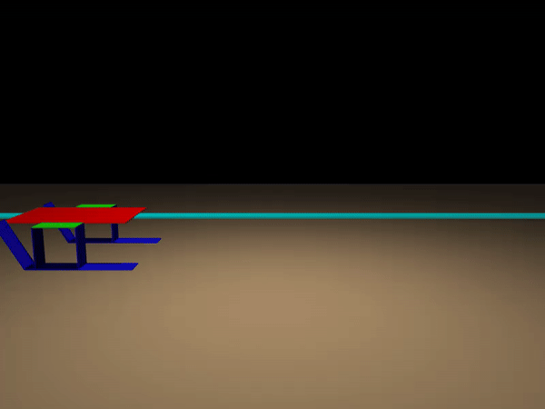
Simulation:
Dynamic Testing

Slide 10
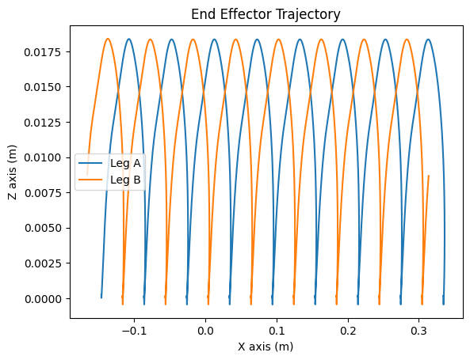
Simulation:
Dynamic testing gait trajectory

Slide 11
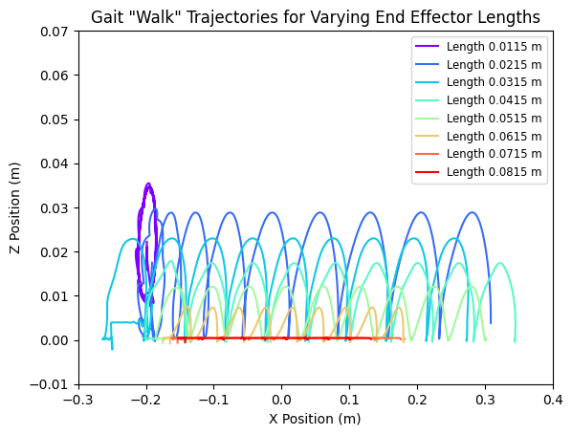
Simulation:
Effect of end effector length on gait trajectory

Slide 12
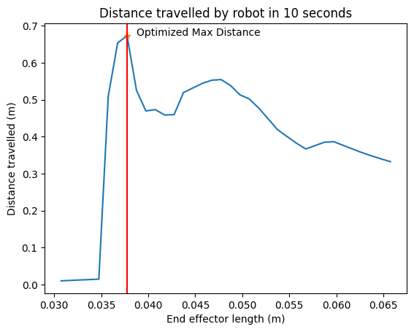
Simulation:
End effector length optimization using distance travelled in 10 seconds

Slide 13
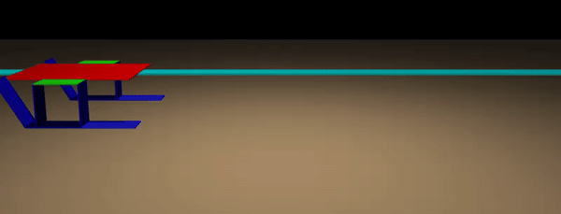
Simulation:
Final simulation using optimized end effector length

Slide 14
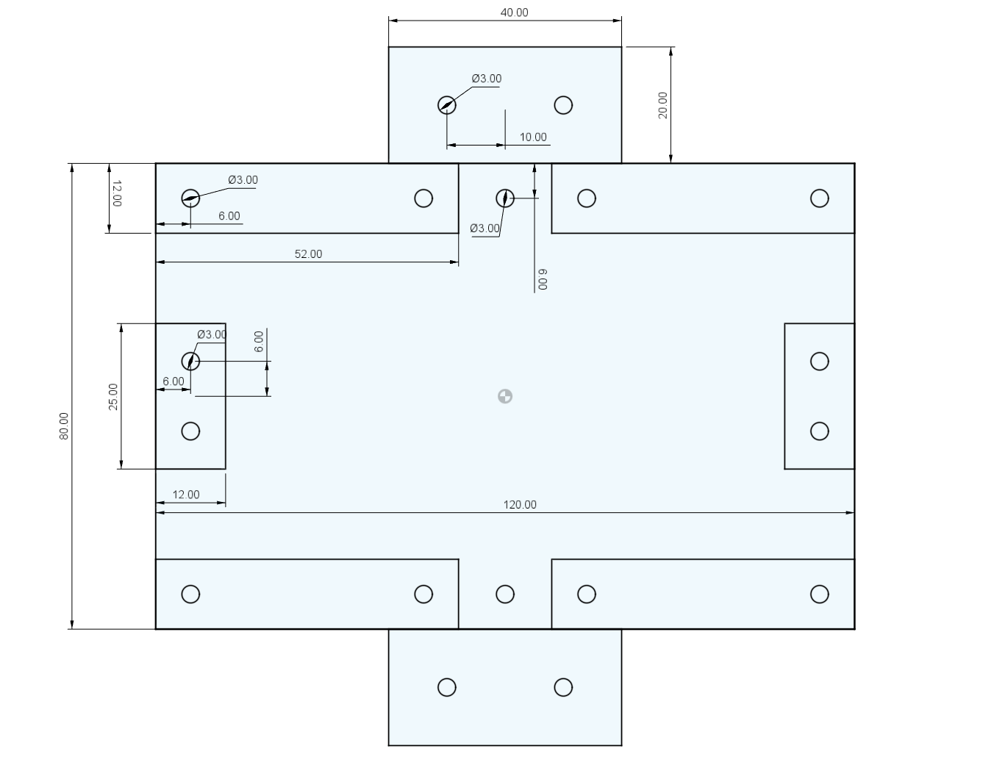
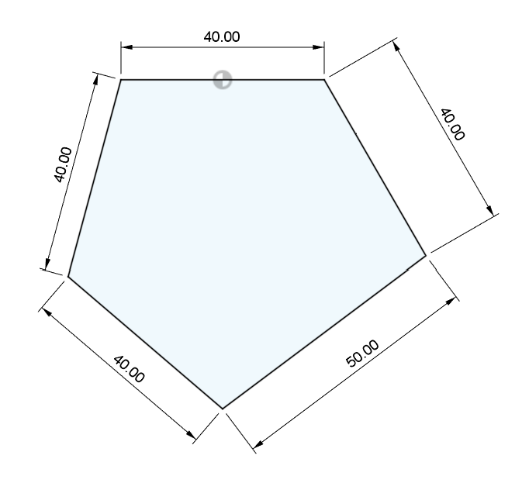
Manufacturing Planning:
Design Assumptions for the robot

Slide 15
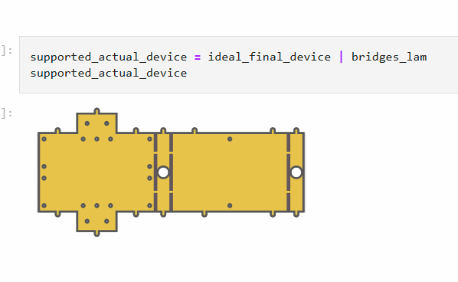
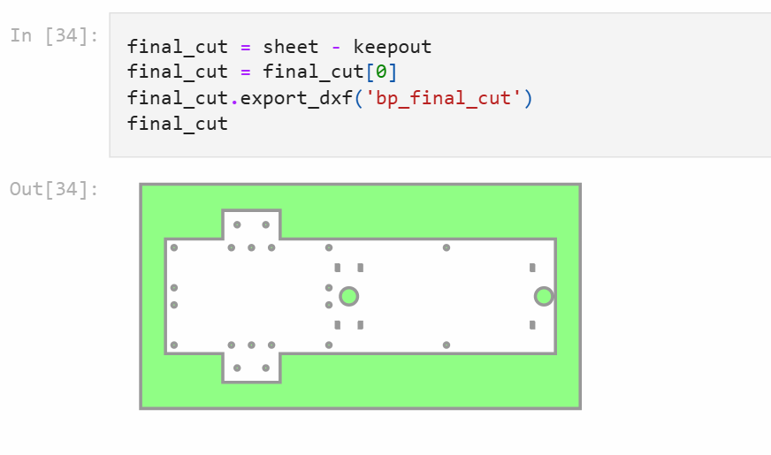
Manufacturing Planning:
DXF generation for the robot using plain hinges

Slide 16
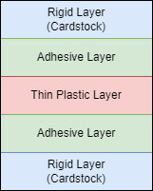
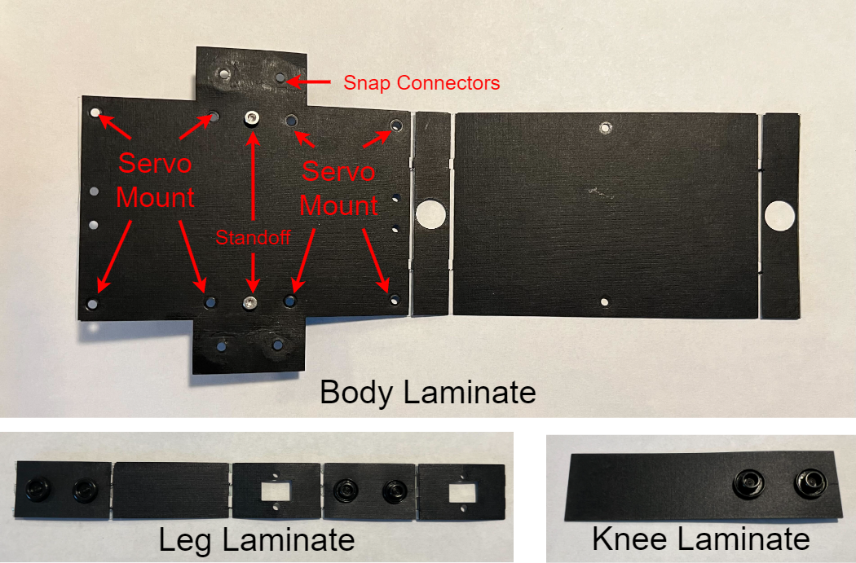
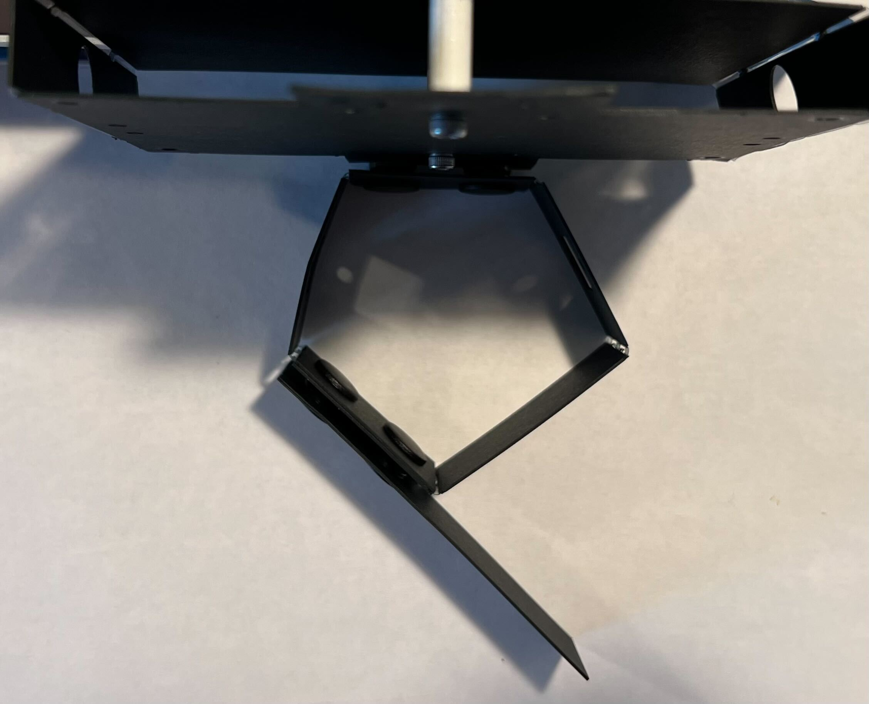
Manufacturing Planning:
Cardstock Prototyping- Bipedal Robot Version 1

Slide 17
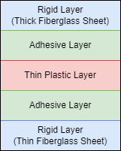
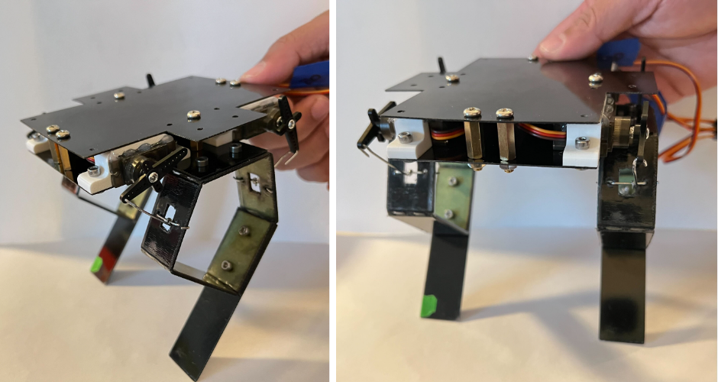
Manufacturing Planning:
Fiberglass Prototyping- Bipedal Robot Version 2

Slide 18
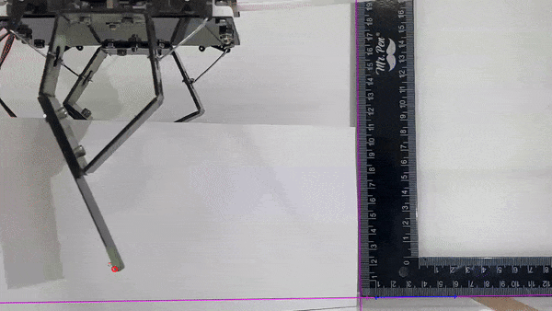
Experimental Setup:
Static testing to track the end effector position

Slide 19
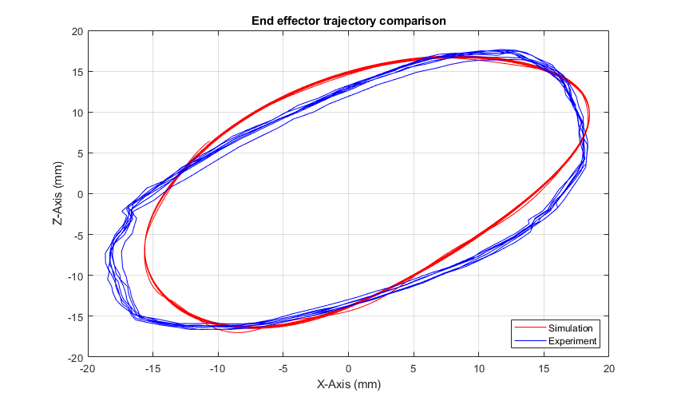
Results:
End effector trajectory comparison with simulated trajectory

Slide 20
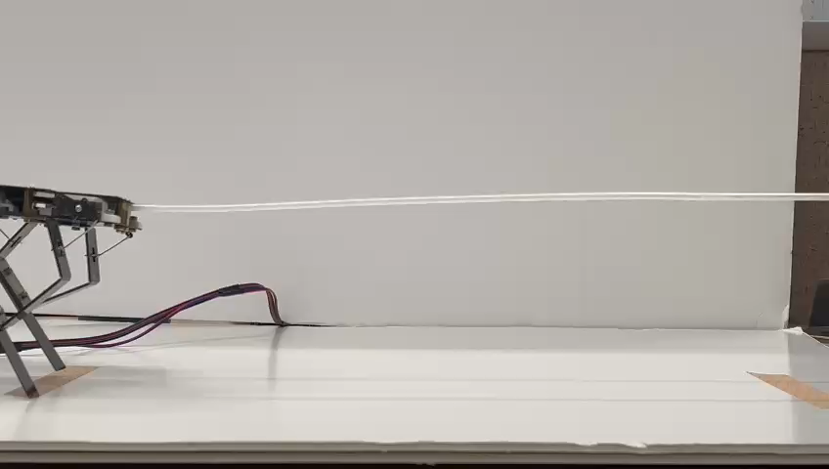
Results:
Final walking robot with optimized end effector link length.

Slide 21
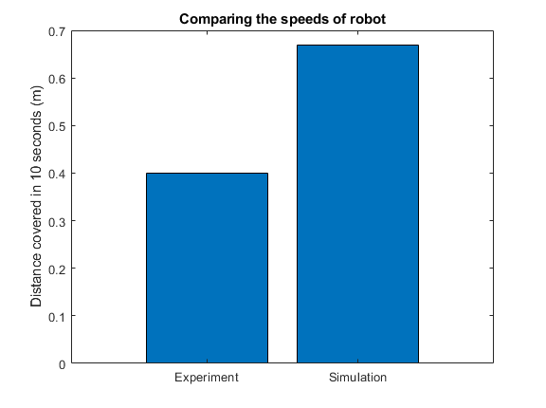
Results:
Robot speed comparison.

Slide 22
Conclusion:
Studied the effect of end-effector length on the gait trajectory.
Simulated the robot using MuJoCo to understand and optimize the kinematics and dynamics of the robot
Utilized techniques of manufacturing planning to generate dxf files to cut and prototype the robot
Implemented joint angles control using Arduino controller to mimic the walking gait
Performed experimental analysis to validate the simulation study.

Slide 23
The End

